Slide 1
Heuristic Algorithms Strategy
BUAD 5042 Heuristic Algorithms

Slide 2
Heuristics Algorithms
Already discussed HAs:
Automate This!
Algorithms
A sequence of steps providing a solution
“Heuristic”
necessarily optimal, or “approximate”
HAs used when an optimal algorithms
Take too long …
For a timely answer
Too late to take action

Slide 3
Heuristics Algorithms
For example…
Business problems are most often combinatorial in nature
Discrete choices with many possible combinations
You already talked about the TSP
(n - 1)! or (n - 1)!/2 possible routes among n cities
5 cities; 12 routes
20 cities; 6.1 × 10¹⁶ routes
Enumeration works for 5 cities, not for >=20
Enumeration: computing all possible solutions

Slide 4
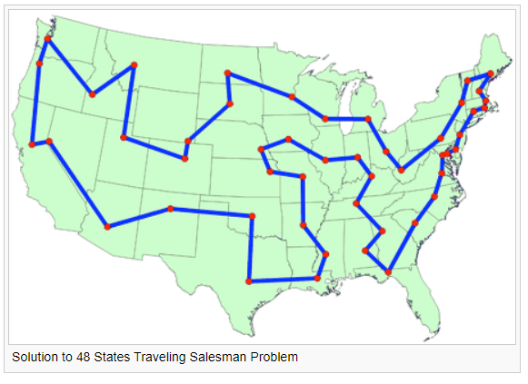
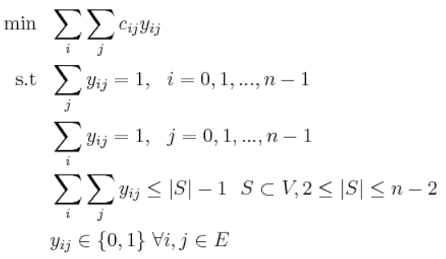
Intuitive Solution Traits
Traveling Salesperson Problem

Slide 5
Steps to Develop an Algorithm!
Steps
1: Outline a logical approach, step-by-step
In words (not even pseudo code yet)
Don’t worry about the programming details yet
2: Plan your programming implementation
Choose appropriate data structures for outline
Write pseudo code
3: Write the program and debug
Write your algorithms in chunks, functions
Write a line, then test it
As you plan, think about speed and accuracy
Do not skip Steps 1 and 2!!!
⇒

Slide 6
Logical Approach Alternatives
Many possible approaches to HAs:
Identifying intuitive traits of good solutions
Greedy methods
Solving related, but simpler problems
Then, adjust the base solution for feasibility
Divide and Conquer
Decompose a complex problem into multiple simpler problems that are solved independently
Derive insight from a model (equations)
Dynamic Programming
Construct a parameterized decision structure
Optimize the parameters

Slide 7
Intuitive Solution Traits
What characteristics would you intuitively expect of the links in the optimal (or good) solution to the TSP?
How would you create an algorithm based on the responses to the question above?

Slide 8
Greedy Algorithms
A greedy algorithm for the TSP:
Sort links in descending order of distance
Iterate from top to bottom of the list, selecting links that do not violate a feasible solution
Stop when the next link creates feasible solution

Slide 9
Greedy Algorithms
Traveling Salesperson Problem
Greedy solutions not guaranteed to be optimal

Slide 10
Greedy Algorithms
Traveling Salesperson Problem
Greedy solutions can be very good

Slide 11
Greedy Algorithms
“Greedy” algorithms often are the first to come to mind
Easy to think of
Easy to code
Easy to explain
Sometimes pretty good, but not always
“Greedy” = “Myopic”
Let’s work a greedy solution

Slide 12
Greedy TSP Example

Slide 13
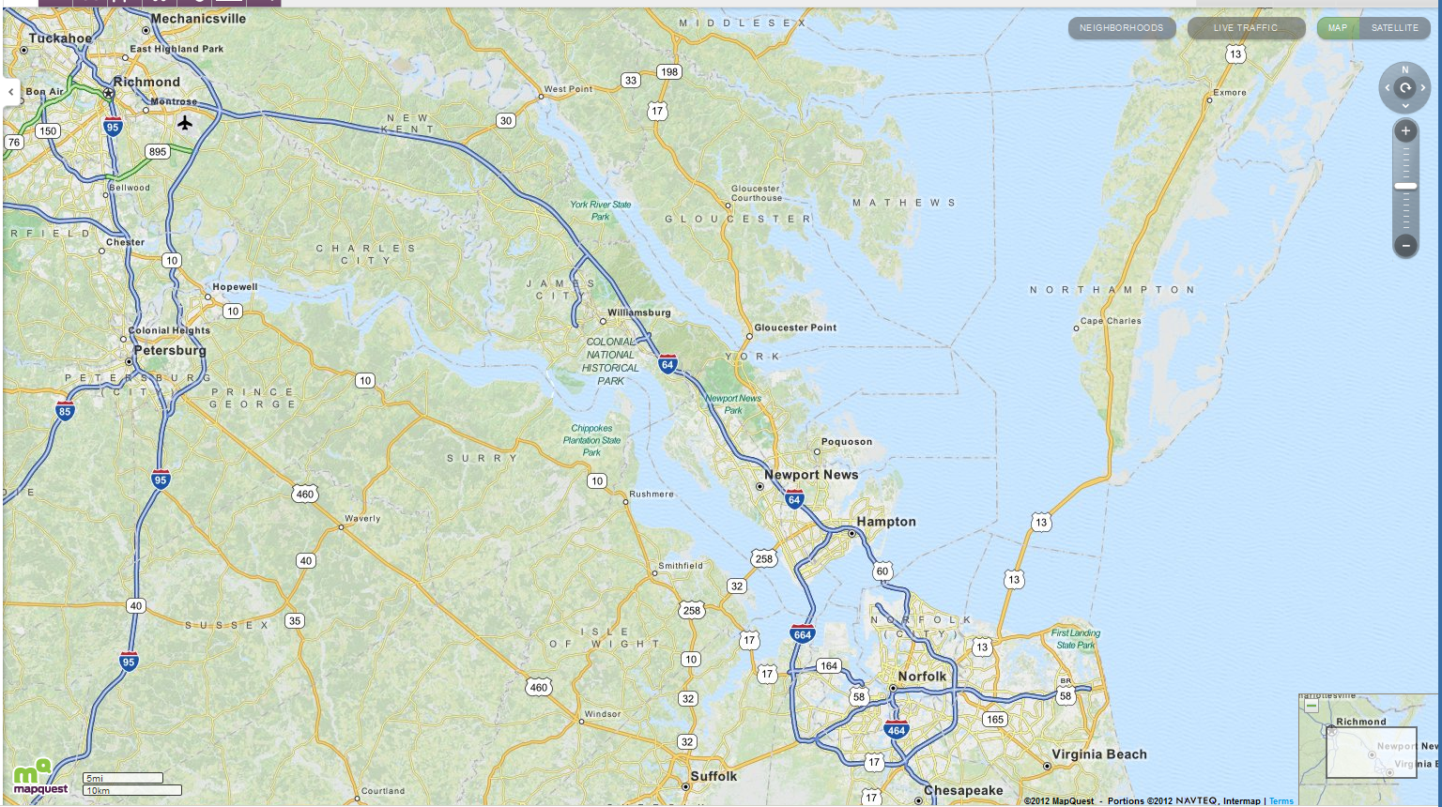
Greedy TSP Solution
Selected Infeasible
 | Richmond | NN | Petersburg | Norfolk | Chesapeake | VA Beach
Richmond
NN | 77.0
Petersburg | 23.6 | 69.0
Norfolk | 93.0 | 18.0 | 76.6
Chesapeake | 95.3 | 19.3 | 76.3 | 2.6
VA Beach | 105.6 | 34.2 | 93.7 | 17.9 | 19.0

Slide 14
Greedy TSP Solution
Selected Infeasible
 | Richmond | NN | Petersburg | Norfolk | Chesapeake | VA Beach
Richmond
NN | 77.0
Petersburg | 23.6 | 69.0
Norfolk | 93.0 | 18.0 | 76.6
Chesapeake | 95.3 | 19.3 | 76.3 | 2.6
VA Beach | 105.6 | 34.2 | 93.7 | 17.9 | 19.0
237.7 miles

Slide 15
Nearest Neighbor Greedy Algorithm

Slide 16
Nearest Neighbor TSP Solution
 | Richmond | NN | Petersburg | Norfolk | Chesapeake | VA Beach
Richmond
NN | 77.0
Petersburg | 23.6 | 69.0
Norfolk | 93.0 | 18.0 | 76.6
Chesapeake | 95.3 | 19.3 | 76.3 | 2.6
VA Beach | 105.6 | 34.2 | 93.7 | 17.9 | 19.0
Start in Richmond

Slide 17
Nearest Neighbor TSP Solution
 | Richmond | NN | Petersburg | Norfolk | Chesapeake | VA Beach
Richmond
NN | 77.0
Petersburg | 23.6 | 69.0
Norfolk | 93.0 | 18.0 | 76.6
Chesapeake | 95.3 | 19.3 | 76.3 | 2.6
VA Beach | 105.6 | 34.2 | 93.7 | 17.9 | 19.0
237.8 miles
Start in Richmond

Slide 18
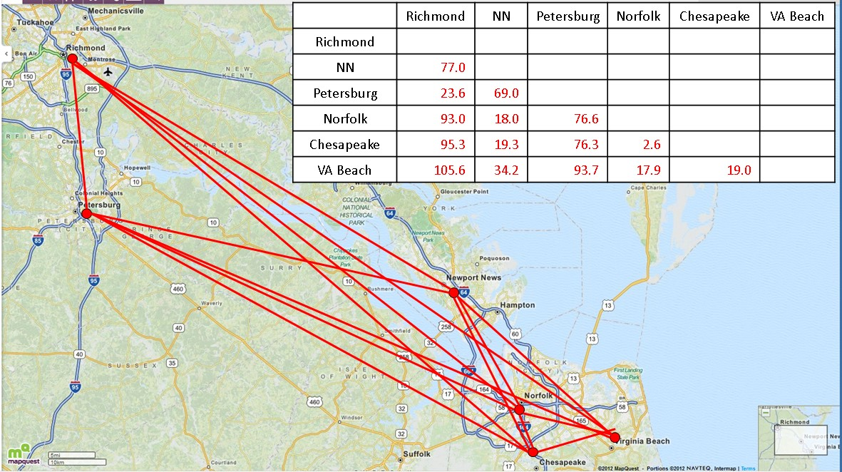
Solve a Simpler Problem
TSP Problem

Slide 19
Solve a Simpler Problem
TSP Problem is difficult…
But the Minimal Spanning Tree (MST) problem is easy
“Construct a network that connects all points using the links whose distances sum to the least possible value.”
Solution does not need to be a round trip
We’ll talk in more detail about possible algorithmic approaches
Important for engineering a gas distribution pipeline, electric grid, etc.
Also project planning, resource allocation

Slide 20
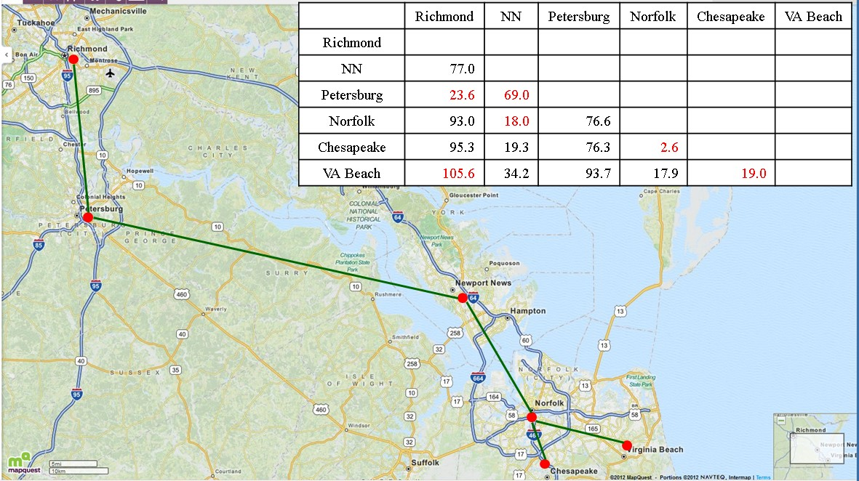
Solve a Simpler Problem
Approximate TSP with MST solution
Then, convert MST to feasible TSP solution

Slide 21
Solve a Simpler Problem
Approach 1: Follow outer path

Slide 22
Solve a Simpler Problem
Approach 1: Reconnect as feasible TSP

Slide 23
Solve a Simpler Problem
Approach 2: Break infeasible link, follow outer path

Slide 24
Solve a Simpler Problem
Approach 3: Follow outer path

Slide 25
Solve a Simpler Problem
Or, do all 3 approaches
Then choose the best
You can think of other approaches
Greedily break longest, infeasible links
Greedily reconnect clusters in feasible fashion
Is a greedy algorithm satisfactory
Performance:
Speed
How good are the solutions?
Difficulty:
How difficult is an algorithm to code without errors?

Slide 26
Divide & Conquer
Intelligent facility location
Select next DC location
Assign customers to DCs
Determine truck routes
DC
DC
DC
DC
DC
DC
DC
DC
DC
Possible DC Location
DC
Existing DC Locations
Customers

Slide 27
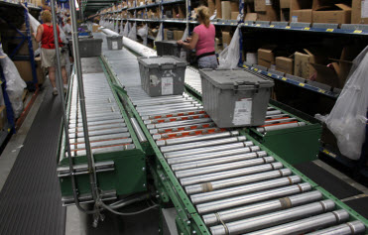
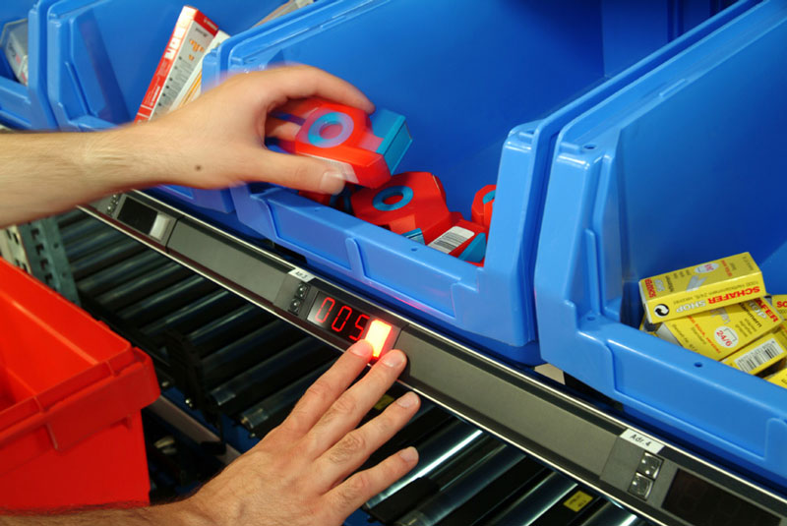
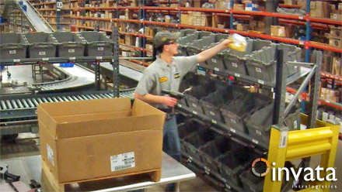
Derive Insight from a Model
Which items to load trucks at a Wal-mart DC?
http://livhaven.com/phoenix-contact-pcs- control-conveyors-at-distribution-centers/
http://www.ssi-schaefer.us/automated-systems/system s-products/picking-systems/pick-to-light.html
Different picking areas…
Each with products having different demand characteristics (mean, std. dev.)
http://www.invata.com/warehouse-automation/ order-fulfillment-systems/put-to-light/

Slide 28
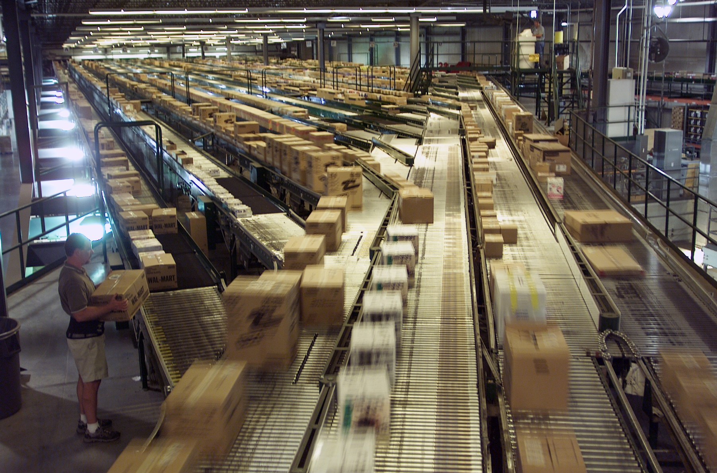
Derive Insight from a Model
Merged into one conveyor
http://corporate.walmart.com/_news_/media-library/photos/logistics-truck-fleet/distribution-center

Slide 29

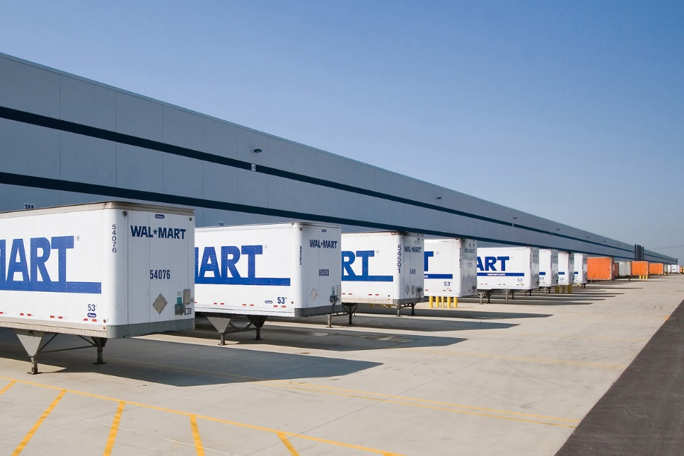
Derive Insight from a Model
Which items to load trucks at a Wal-mart DC?
Stores replenished based on what sold today
Trailers ship when full
Some items left in partially filled trailer at the end of the day
“Residual replenishment”

Slide 30
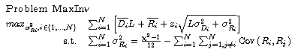
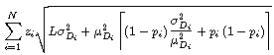
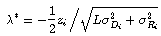
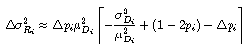
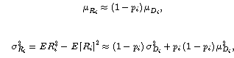
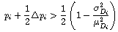
Derive Insight from a Model
Make some simplifying assumptions and write equations reflecting material movement
Analyze and interpret:
Minimize inventory by first loading items with small demand means and relatively large demand standard deviations
This is a greedy algorithm!

Slide 31
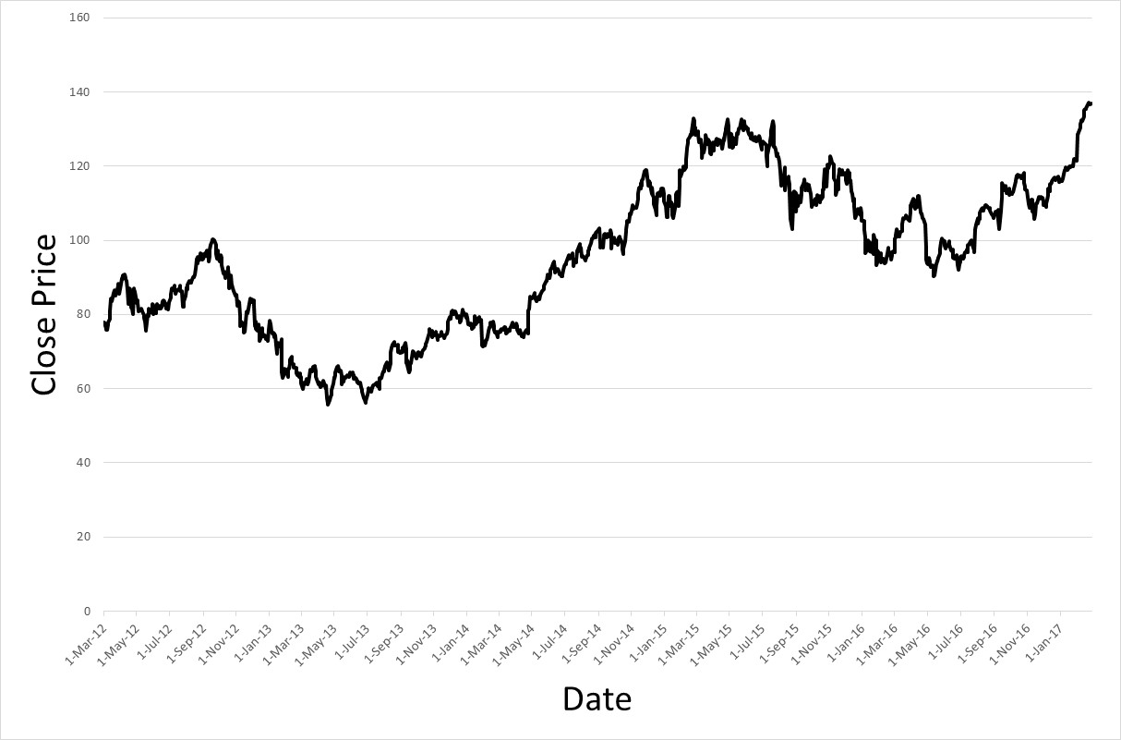
Parameterized Decision Structure
Financial investment problem
Set thresholds for buy-sell decisions
Sell (S)
Buy (B)
Could set S = (1 + r)×B or S = B + r

Slide 32
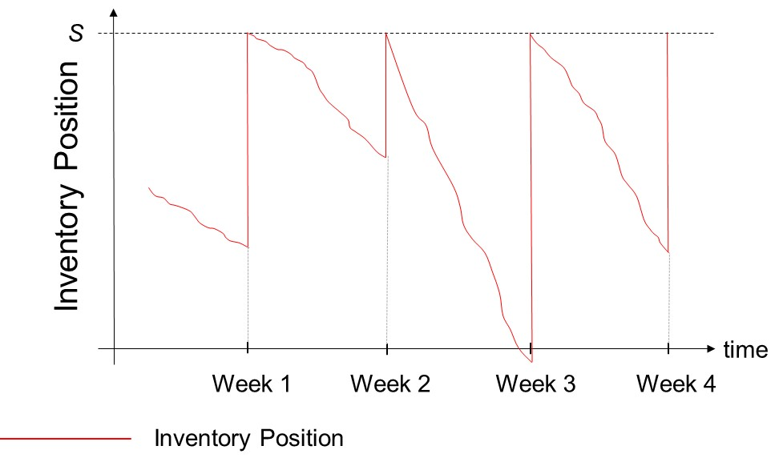
Parameterized Decision Structure
Parameterized inventory reordering decision
Find optimal stock-up-to level

Slide 33
Dynamic Programming
We’ll talk about this later!
In a sense, this is one specific way to break a big problem into many smaller, and easier problems

Slide 34
Logical Approaches to Algorithms
This course is organized around these various approaches
Developing a successful algorithms hinges, first, on picking a good approach from all the possible approaches
You often need to try several approaches and select the best one
These approaches suggest the “set of steps” to develop an algorithm
Provides a logic development approach
Resolves the “Where do I start” problem

Slide 35
Additional Content

Slide 36
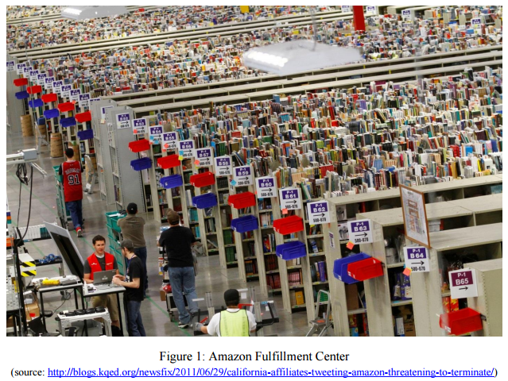
Parameterized Decision Structure
Determining paths for Amazon fulfillment center pickers
Which of the possible locations for each item should be selected?
Which orders to assign to which cart trip?

Slide 37
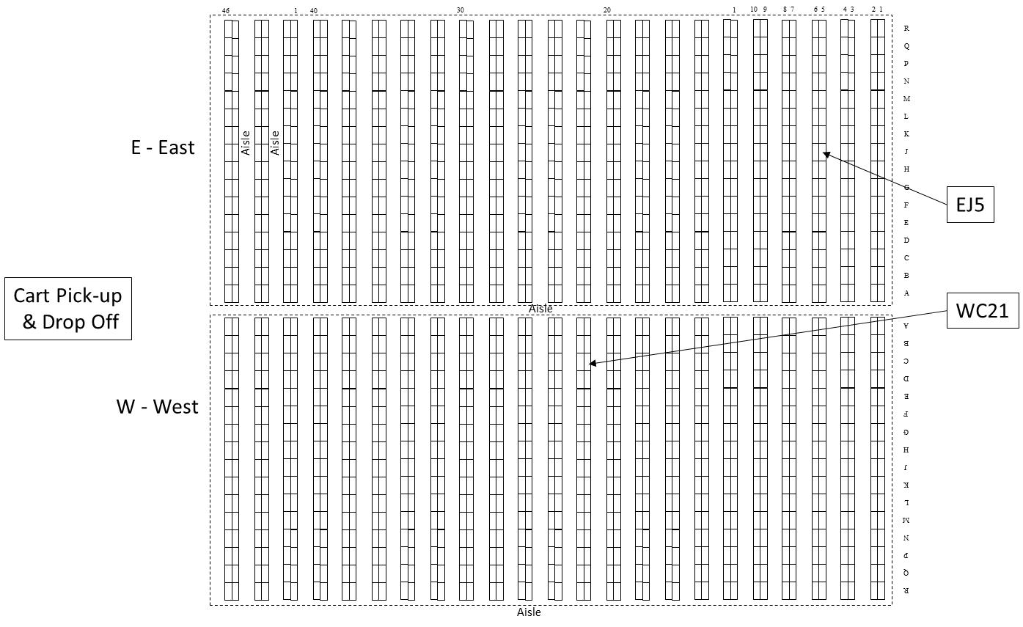
Geographical Parameters

Slide 38
Geographical Parameters

Slide 39
Geographical Parameters

Slide 40
Geographical Parameters

Slide 41
A Couple Final Thoughts
Algorithmic Enhancements
Post processing improvement routines
Other issues we’ll cover:
How good is an algorithm?
Is it optimal or an approximation?
If heuristic, how close to optimal?
How fast is an algorithm?

Slide 42
Solve a Simpler Problem
Approach 2: Break links with 3 connections

Slide 43
Solve a Simpler Problem
Approach 2: Alternative 1a

Slide 44
Solve a Simpler Problem
Approach 2: Alternative 1b

Slide 45
Solve a Simpler Problem
Approach 2: Alternative 2

Slide 46
Solve a Simpler Problem
Approach 2: Alternative 3

